Slide 1
Procedural Generation
Rogue, Roguelikes, and Roguelites

Slide 2
What is it?
Creation of levels, items, and enemies not by the designer, but by the game itself
Why do it?
Replayability
Allows for emergent storytelling rather than designed storytelling
Players have move variance – skill is still a factor but it gives chance more of a position than it would have otherwise

Slide 3
What is Rogue?
Dungeon Crawling adventure game released in 1980
Thematically inspired by Dungeons and Dragons
Inspired by text based games such as Colossal Cave Adventure

Slide 6
What is Rogue?
Two Critical Features:
Permadeath
Procedurally generated dungeon layouts
Popular in college as was packed in 4.2BSD
Inspired a new genre of dungeon crawlers

Slide 7
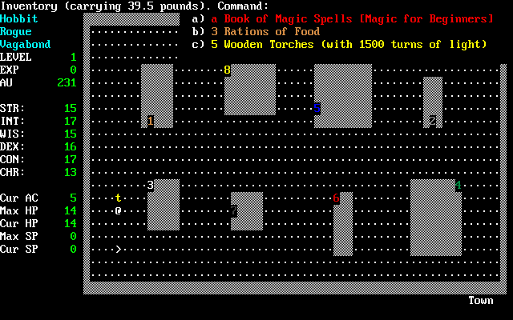
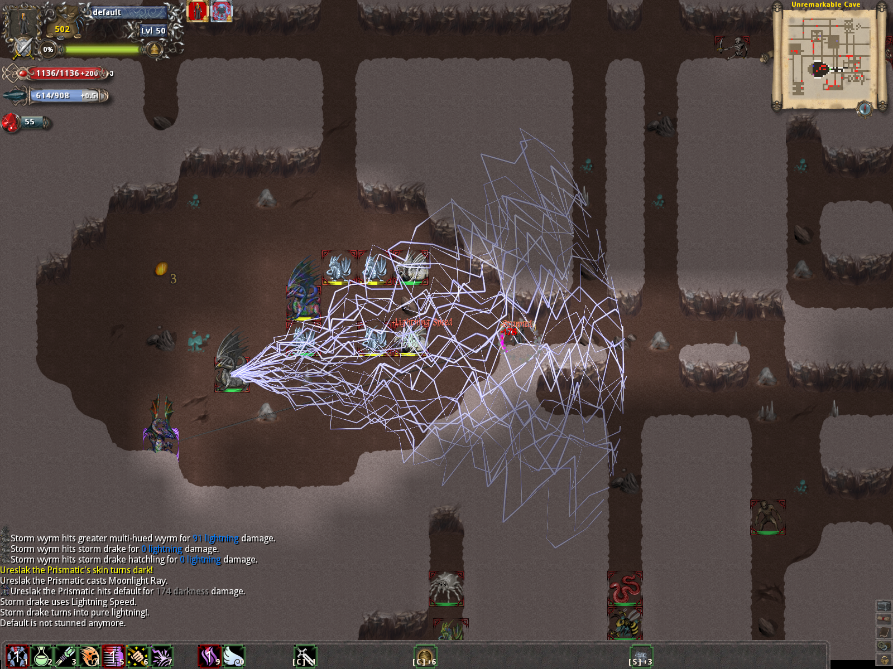
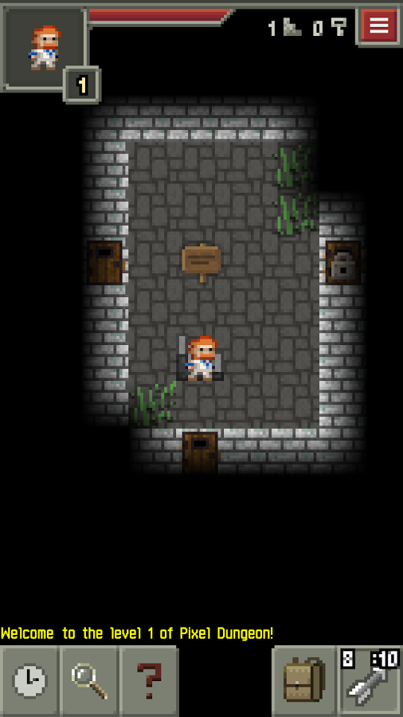
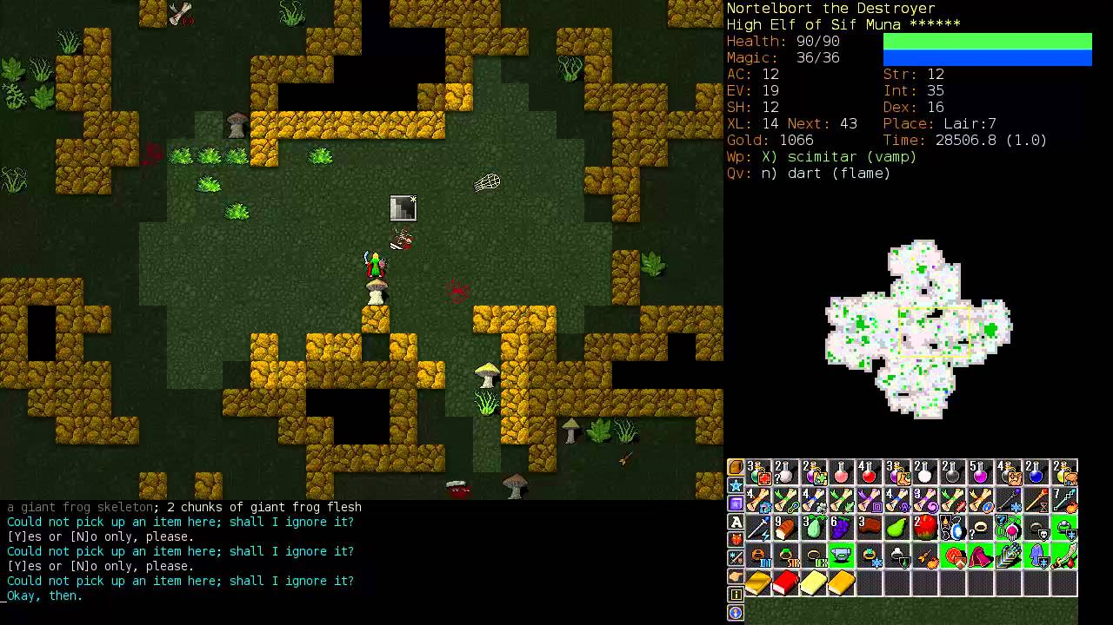
What is a Roguelike?
A dungeon crawler
Has permadeath mechanic
Majority of levels procedurally generated

Slide 8
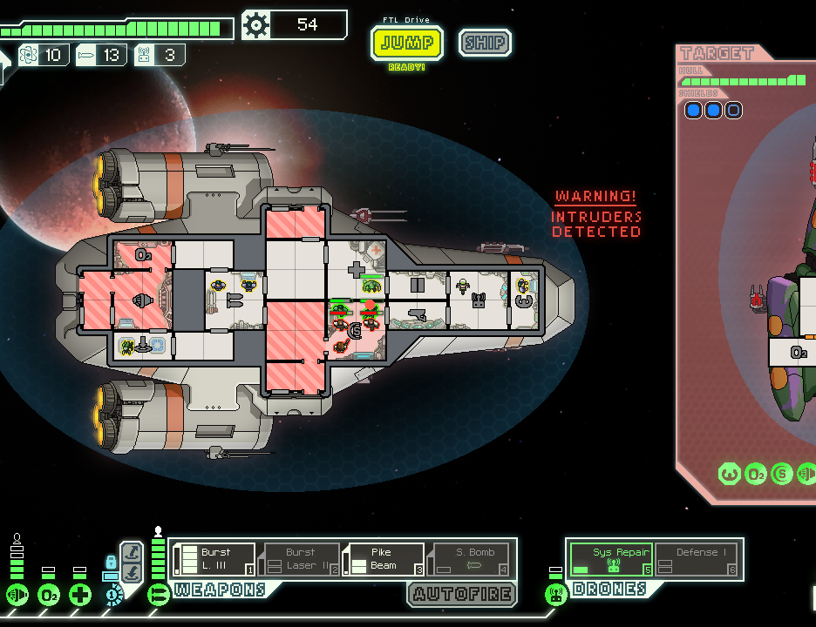
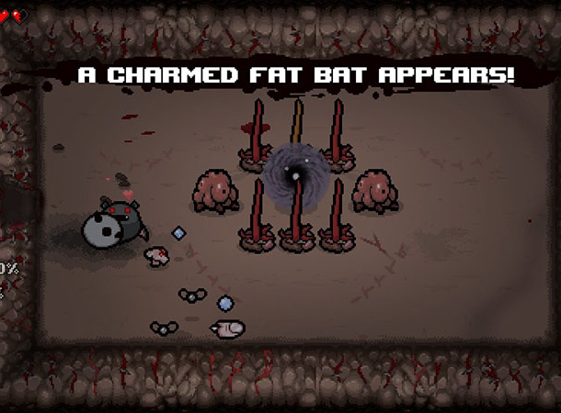
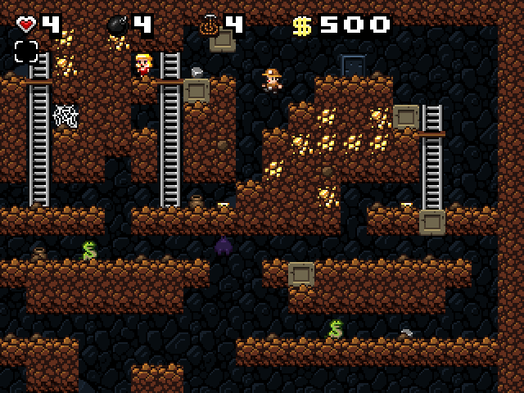
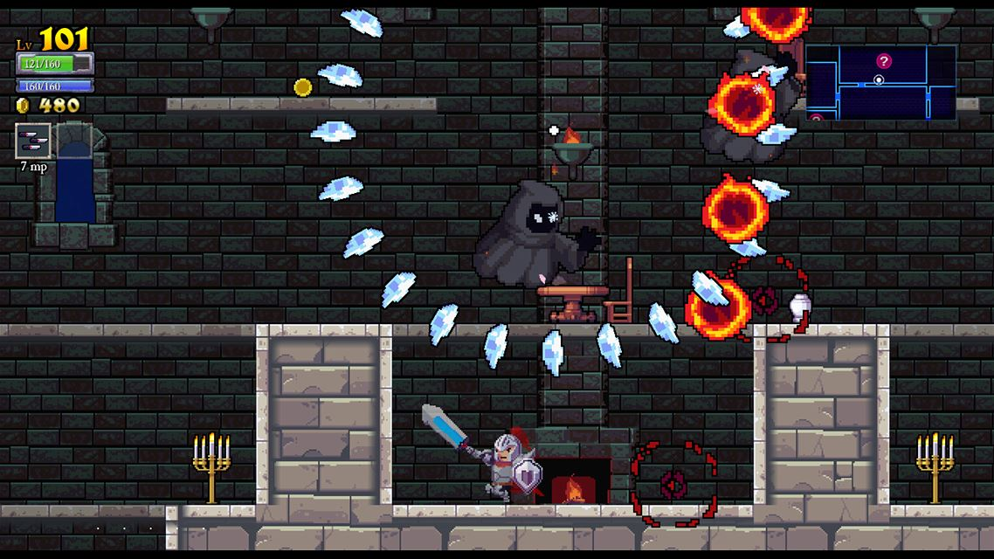
What is a Roguelite?
Relatively new term
Very popular in the indie scene
Describes game with procedurally/randomly generated levels
Usually also has account progression between sessions

Slide 9
How do you procedurally generate?
ALGORITHMS

Slide 10
Naive Solution
Do a random walk
That’s it
Not really used in real games but for student projects or learning a new graphics library, works okay

Slide 12
General Method
Create a series of randomly sized non overlapping or intersecting rooms

Slide 13
Connect them in some way

Slide 14
How

Slide 15
Angband strategy
Select two random rooms
1
Connect them via a random walk
2
Repeat until completed
3

Slide 17
Delaunay Triangulation
Calculate it, then make a minimum spanning free from it

Slide 19
Alternative: Start with maze

Slide 20
Jamis Buck Method
Create a maze
Fill in dead ends until a threshold is met (number of remaining tiles)
Connect some of the remaining dead ends so that the maze is no longer perfect
Pick a room size, find a place it fits, place in the location closest to passages
Connect to room via a door
Repeat

Slide 21
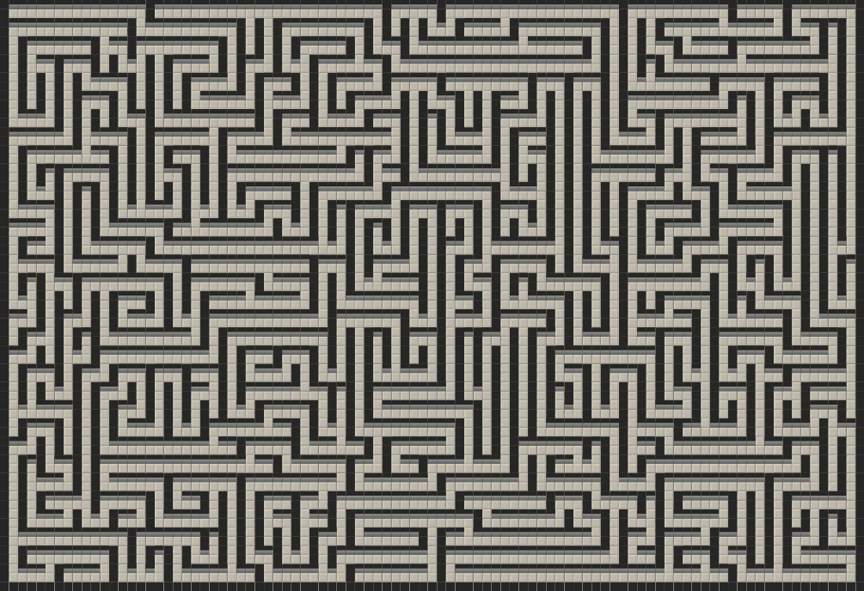
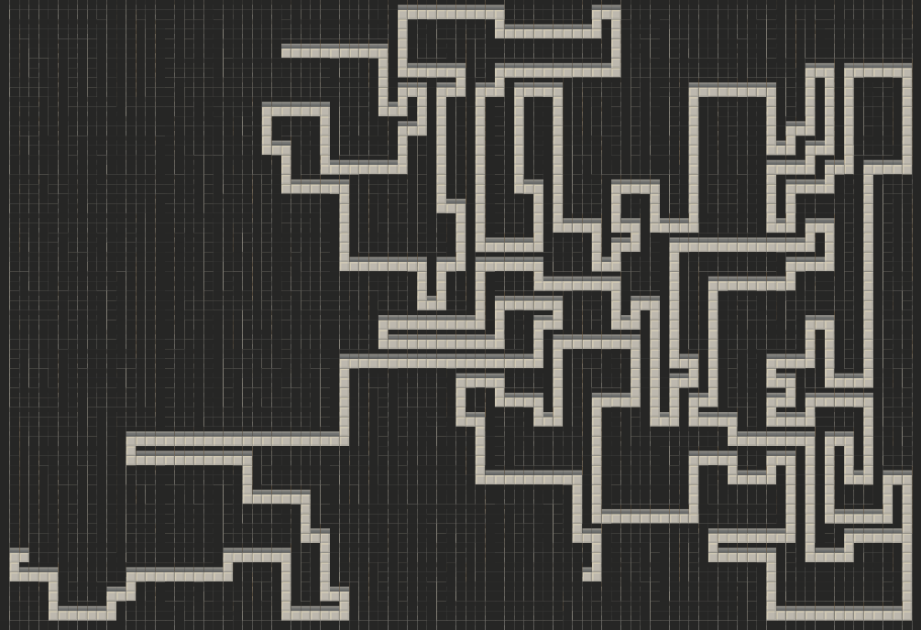
Before and after, threshold 1000

Slide 22
Combination Strategy
Create rooms
Flood Fill mazes in the rest of open spaces
Connect rooms and mazes to closest connection points
Walk back dead ends as before

Slide 23
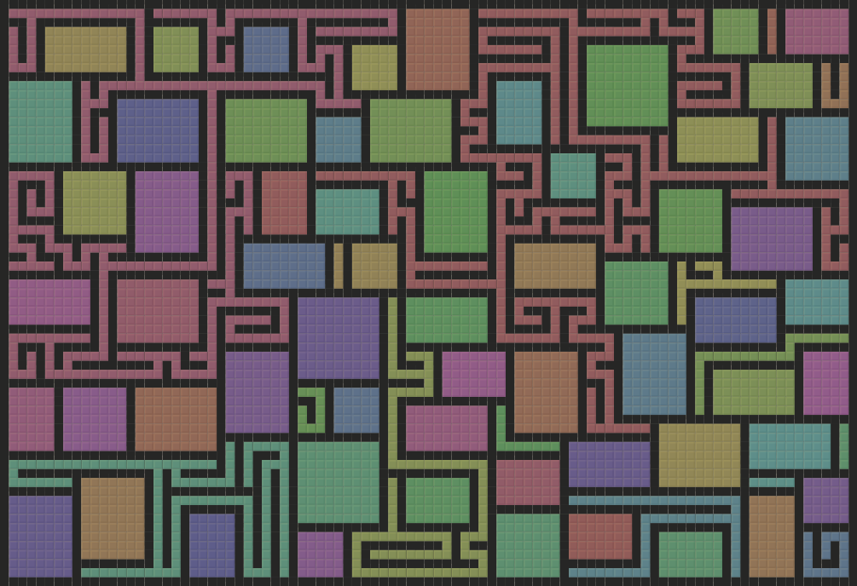
Maze Flood Fill

Slide 25
Final strategy
Used by most games
Take what we have done here
Create smaller “room” or “section” generators
Tailor some floors to generate specific patterns
Have designers create set pieces and randomly give them to the player – often done in roguelite

Slide 27
Live Code Demo
Just kidding, I wrote all the code ahead of time

